Slide 1

Advancing Realism and Engagement in Video Games through AI-Powered NPC Behavior and Interaction
AI Applications
National Centre of Scientific Research "Demokritos“
Alexandros Filios – mtn2219

Slide 2
TABLE OF CONTENTS
01
INTRODUCTION & BACKGROUND
02
OBJECTIVES
03
CHALLENGES
Exploring the potential of AI-powered NPC behavior to advance realism and engagement in video games.
Creating lifelike NPC behavior and enhancing player immersion, engagement, and storytelling.
Addressing the complexities of modeling human behaviors, scalability, and maintaining a balance between realism and player interest.
04
IMPLEMENTATION PLAN
Collecting data, developing machine learning models, integrating AI into NPC behavior algorithms, testing, refining, and optimizing for performance.
05
POSITIVE IMPACT
Enhancing immersion, advancing storytelling and role-playing elements, increasing replayability, and driving AI and machine learning development in gaming.

Slide 3

INTRODUCTION & BACKGROUND
Importance of NPCs in gaming
Limitations of current NPC behavior
Potential of AI-powered solutions

Slide 4



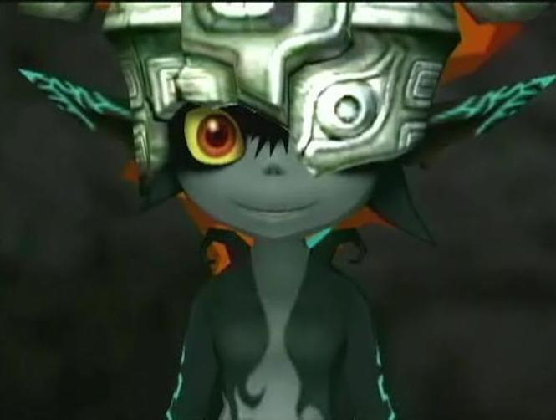
INTRODUCTION & BACKGROUND

Slide 5
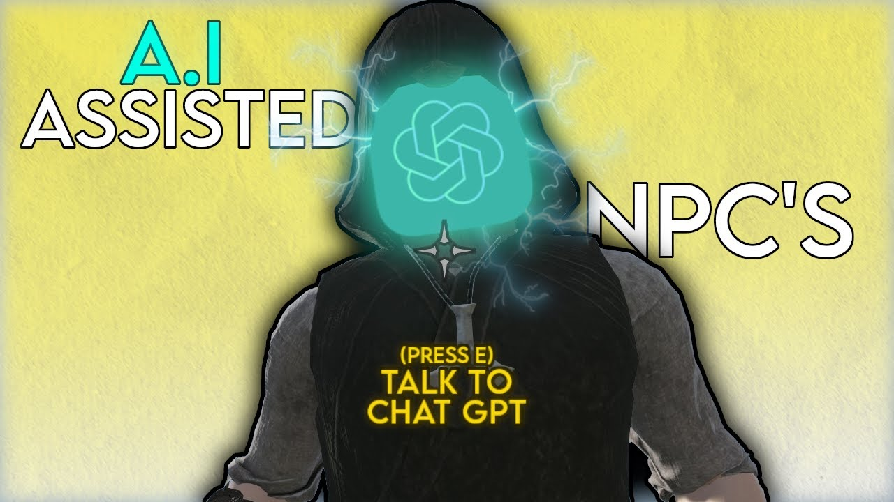
OBJECTIVES PART 1
Enhancing NPC Behavior with multiple choices and actions using Deep Reinforcement Learning Algorithms
Immersive Gameplay by reacting dynamically to player action
Enhance storytelling with emotionally engaging narrative experience by suing Pre-trained Transformers like Chat-Gpt

Slide 6

CHALLENGES
Ensuring Realistic and Engaging NPC Behavior
Modeling Complex Human Behaviors & Emotions
Computational Efficiency in Open-World Games
Balancing Realism and Player Interest
Data Collection and Training
Testing and Iterative Design

Slide 7

IMPLEMENTATION PLAN PART 1
Collect data on human behavior, emotions, and social dynamics.
Utilize deep learning, reinforcement learning, and natural language processing techniques.
Integrate the developed models into NPC behavior algorithms.
Optimize the AI system for performance and scalability.

Slide 8
IMPLEMENTATION PLAN PART 2
 | Realistic NPC Behavior | Engaging NPC Interaction | Improved Immersion | Enhanced Replayability
Data Collection | True | True | False | False
Model Development | True | True | True | False
Integration into NPC Behavior Algorithms | True | True | True | False
Iterative Design and Player Feedback | True | True | True | True

Slide 9

POSITIVE IMPACT PART 1
Enhanced Immersion in Virtual Realities
Dynamic and Evolving Game Experiences

Slide 10

POSITIVE IMPACT PART 2
Cognitive and Emotional Engagement
Pushing the Boundaries of AI and Machine Learning

Slide 11
THANK YOU
Questions?

